Slide 1

School of Computing Science and Engineering
Path finding visualizer
Submitted by: Submitted to:
Rajat Mittal - 21SCSE1010465 Dr. Monika Jain
Samir - 21SCSE1010597
Himanshu Arya - 21SCSE1010864 Mentor :
Ankita Surbhi - 21SCSE1010941 Dr. Gaurav Sharma
PROGRAMME NAME: BTECH – CSE (CORE)

Slide 2
Introduction
The goal of this project is to creating e-learning tool that also helps in improving computer science education very much.
Path Finding Visualizer which can be used to visualize the shortest path algorithm.
The conceptual application of the project is to visualize different path algorithms or graph algorithms to find shortest path from source to the destination.
Path finding algorithms build on top of graph search algorithm and traversing through relationships until the destination has been reached.
These algorithms find the cheapest path in the term of the number of hops or weights.
Keywords : Dijkstra's algorithm , Best-First search , A* algorithms

Slide 3
Introduction
What is a path finding visualizer?
A Path finding visualizer that uses different algorithms to visualize a path on a grid. Notably A * and dijkstra. Also has the functionality to generate different mazes using different maze generating algorithms. So one can play around, visualize the difference in efficiency of different path finding algorithms on a bigger and more complicated scale.
Problem Definition
In today’s time there are multiple routes of travelling to a particular destination but we don’t know the most time sufficient route. This problem has still not been solved which can cause a lot of time management crisis and can also lead to wastage of fuels which hence makes it very cost consuming. Since not everywhere there is internet connectivity so once we go offline, we lose our destination path which can create a lot of obvious problems

Slide 4
Applications
NPC movement.
Needs to be smart and fast.
• Games use grids to describe the environment.
• Network routing
• Image processing
• A.I. Path finding

Slide 5
Algorithms for Path finding
Dijkstra’s Algorithm
Best-First Search
A*

Slide 6
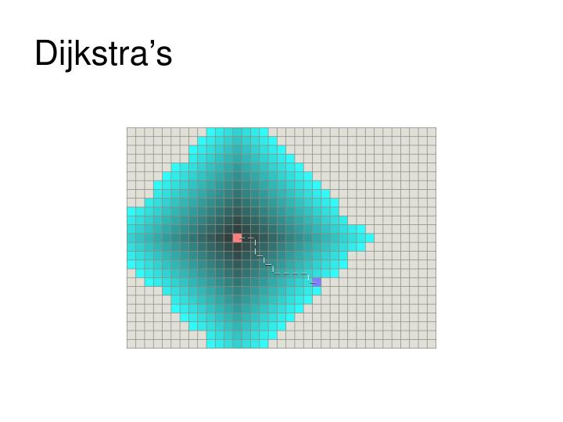
Dijkstra's algorithm
Visits vertices starting from starting point
Looks at all closest vertices to the starting point
From these points, we check the closest neighbors
Stop checking once goal is reached
Guaranteed shortest path
Time consuming

Slide 7
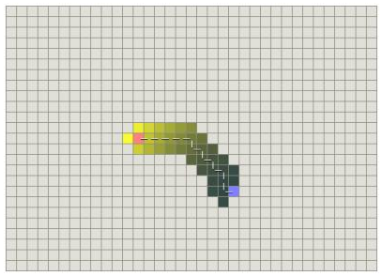
Best-first search
Similar to Dijkstra’s
Difference: Has a heuristic (estimate) to tell it how far the goal is from any vertex
Selects vertex closest to the goal instead of closest to starting point
Does not guarantee shortest path
Very fast

Slide 8
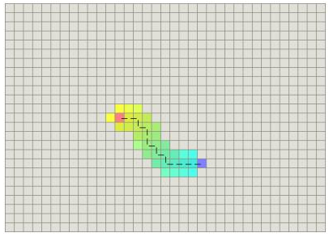
A* algorithms
Combines the use of g(n) and h(n)
f(n) = g(n) + h(n)
A* finds the vertex n with the lowest f(n)
Continues to find vertices with the lowest f(n) until the goal is reached
Guarantees shortest path
Relatively fast

Slide 9
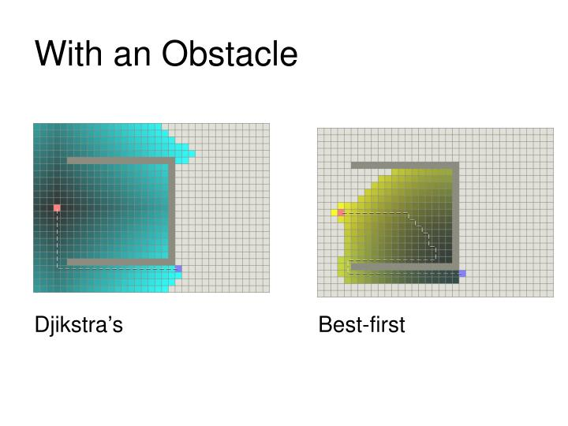
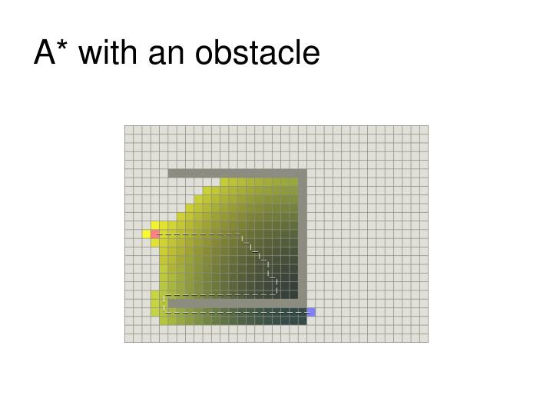
Algorithms with an obstacle

Slide 10
Why Use Best First Search and Dijkstra?
Best First Search works faster than Dijkstra’s .
But does not guarantee an optimal path.
We want some combination o Dijkstra’s and Best First Search.
Enter A*!

Slide 11
Other Path finding algorithm
• Breadth-first search and depth-first search
• Many versions of A*
• Lowest cost first
• Heuristic depth-first
• Iterative deepening
• Bidirectional
• Recursive best-first

Slide 12
Why use Path Finding algorithm ?
EXISTING PROBLEMS
In today’s time there are multiple routes of travelling to a particular destination but we don’t know the most time sufficient route. This problem has still not been solved which can cause a lot of time management crisis and can also lead to wastage of fuels which hence makes it very cost consuming. Since not everywhere there is internet connectivity so once we go offline, we lose our destination path which can create a lot of obvious problems.
PROPOSED SOLUTIONS
Our visualizer will help solve all the above-mentioned problems. It will give the user most time and cost sufficient, i.e., the shortest route to reach their desired destination. Even if the networks fail the user can still access the map with the help of our offline feature which supports the satellite view as well as the road view in order to reach his/her desired destination. The offline feature would come in very handy for elderly people who sometimes may face issues while using a smartphone with internet connectivity.

Slide 13
Why use Path Finding algorithm ?
TOOLS AND TECHNOLOGY USED
We are going to build this website with the help of HTML(frontend) and Javascript (backend).
Algorithm Used:
Sorting Visualization(bubble sort, insertion sort, Quick sort)
Path Finding
Maze breadth
FUTURE SCOPE
As a future scope, more Algorithms for Trees, Graphs, Linked List and many more can be added. To empower learning of the learner concept of community learning through forums, discussion and user-based feedback can be added. In future we hope to create an offline app which will have pre-saved routes to popular destinations.

Slide 14
Conclusion
The goal of the sorting visualizer tool is to make use of bars and their comparisons to help understand sorting algorithms.
This is user flow which shows how sorting visualizer tools can be used.
Thus, with our initiative we aim to create to a software which will save time and money and help the user in reaching their destination as soon as possible.
In future we hope to create an offline app which will have pre-saved routes to popular destinations

Slide 15
References
Amit’s A*pages (images from here) http://theory.stanford.edu/~amitp/GameProgramming
AI Depot http://aidepot.com/Tutorial/PathFinding.html
Game AI Page http://www.gameai.com/pathfinding.html
A* algorithm tutorial (code from here) http://www.geocities.com/jheyesjones/astar.html
Games++: Games and Game Programming http://www.gamespp.com/algorithms/pathfinding
A* Pathfinding for Beginners

Slide 16
Thank you

